Slide 1

Treasure Hunt
The following map is drawn using a scale of 1cm : 5 paces

Slide 2





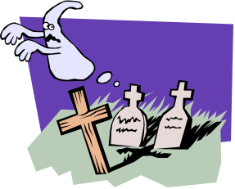

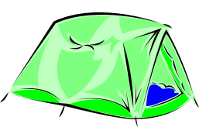
Remember 1cm : 5 Paces
30 paces
15 paces
6cm
2cm
10 paces
3cm
20 paces
x
4cm
25 paces
5cm

Slide 3
Treasure Hunt
The following map is drawn using a scale of 1cm : 10 paces

Slide 4
Remember 1cm : 10 Paces
60 paces
30 paces
6cm
2cm
20 paces
3cm
40 paces
x
4cm
50 paces
5cm

